Slide 1

PROGRAMMING IN PYTHON (LAB)
DEPLOYMENT OF PYTHON APPLICATIONS
Presented By : Tandra Babu
Assigned By : Haranath Rakshit

Slide 2
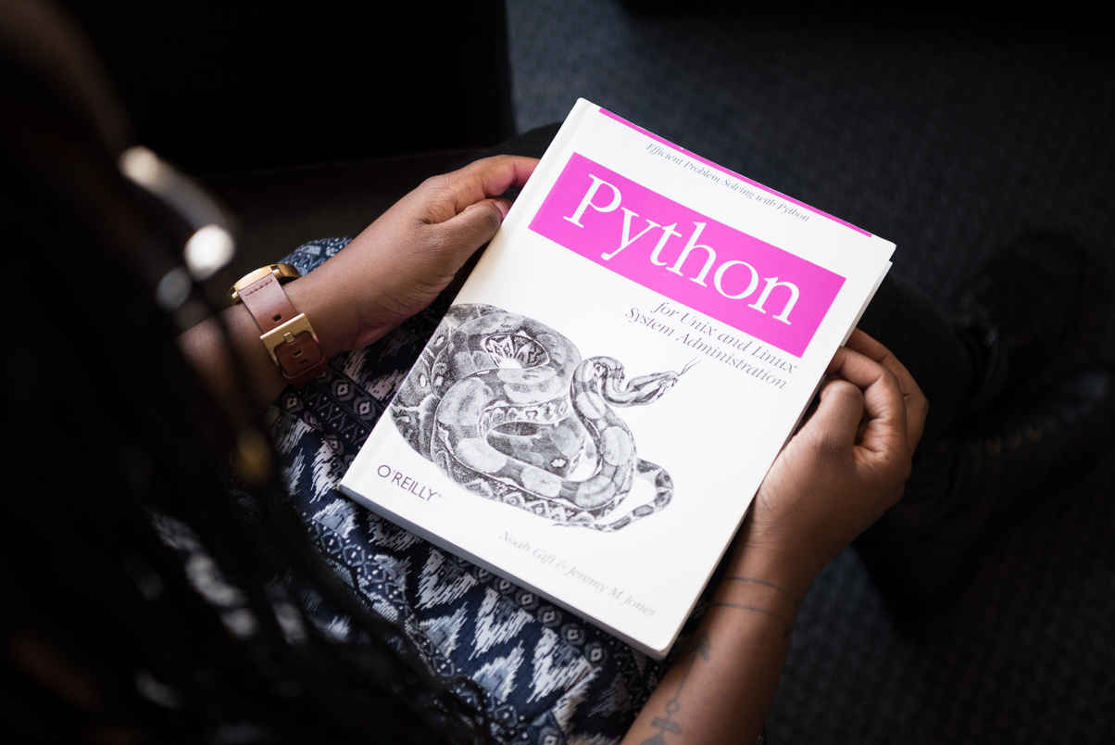
LEARNING OBJECTIVES
This presentation includes :
Understanding what it means to deploy a Python application.
Package Python applications properly using industry tools.
Use virtual environments to isolate project dependencies.
Deploy applications on cloud platforms like Heroku, AWS, or using Docker containers.
Understand the basic concepts of CI/CD to automate your deployment process.

Slide 3
BASICS OF PYTHON
INTRODUCTION
High-level, interpreted, and general-purpose programming language.
Easy-to-read syntax with dynamic typing.
KEY FEATURES
Simple & Expressive
Cross-platform (Windows, macOS, Linux)
Large standard library
Supports OOP & Functional Programming

Slide 4
WHAT IS DEPLOYMENT ?
DEFINITION :
Deployment is the process of making a software application available to users on a server, cloud, or platform.
WHY IS IT IMPORTANT?
Makes your app accessible from anywhere.
Supports scalability and performance.
Enables collaboration, testing, and production-ready systems.

Slide 5
PACKAGING PYTHON PROJECTS USING SETUPTOOLS
WHAT IS PACKAGING ?
Preparing your Python code in a standard format so that it can be easily distributed or installed using pip.
KEY COMPONENTS:
setup.py – A script that contains metadata and instructions on how to build/install the project.
setup.cfg – Optional configuration file for declarative setup.
MANIFEST.in – Specifies extra files to include in the package.
requirements.txt – Lists all the dependencies required for the project.

Slide 6
Virtual Environments (venv, virtualenv)
WHAT IS VIRTUAL ENVIRONMENT?
A self-contained directory that contains a Python interpreter and libraries for a particular project.
WHY USE IT?
Prevents dependency conflicts between projects.
Ensures consistency between development and production.
TOOLS:
venv – Built-in for Python 3.
virtualenv – External tool, supports older versions.

Slide 7
Deployment Platforms Overview
POPULAR PLATFORMS:
Heroku
Simple, beginner-friendly.
Deploy with Git and a Procfile.
Free-tier available for small projects.
3. Docker
Package your app and environment into a container.
Ensures the app runs the same anywhere (dev, test, prod).
Can be deployed to any cloud (AWS, Azure, GCP).
2. AWS (Amazon Web Services)
Offers EC2 (servers), Lambda (serverless), and Elastic Beanstalk (PaaS).
More control and scalability.

Slide 8
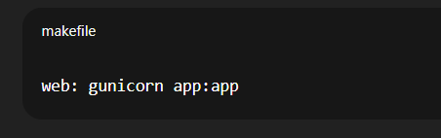
HEROKU DEPLOYMENT WORKFLOW
STEPS:
Install Heroku CLI.
Create requirements.txt, Procfile, and runtime.txt.
Initialize a Git repo and push to Heroku.
Access your app at https://your-app-name.herokuapp.com.
EXAMPLE:
Procfile :

Slide 9
DOCKER BASICS FOR PYTHON
WHAT IS DOCKER?
Docker allows you to containerize your application along with all its dependencies.
WHY USE DOCKER?
Portability: Runs the same across environments.
Consistency: Avoids "it works on my machine" issues.

Slide 10
CI/CD – CONTINUOUS INTEGRATION AND DEPLOYMENT
WHAT IS CI/CD?
CI (Continuous Integration): Automatically test and merge code changes.
CD (Continuous Deployment): Automatically deploy changes to production.
BENEFITS:
1. Faster and safer deployments.
2. Automatic testing reduces bugs.
3. Integration with tools like:
GitHub Actions
GitLab CI/CD
Jenkins

Slide 11
PROJECT 1 – DEPLOY BLOG APPLICATION
OBJECTIVE:
Build and deploy a Flask or Django blog application.
KEY STEPS:
Build the app with templates and routes.
2. Use venv and freeze requirements.
3. Prepare for Heroku deployment:
* requirements.txt
* Procfile
* runtime.txt
4. Push to GitHub and deploy using Heroku.

Slide 12
POSSIBLE USE CASES:
1.Personal Blogging Platform:
*A user wants to maintain their personal blog (e.g., travel, tech, lifestyle).
*Can be hosted for free on platforms like Heroku.
2.Educational Portfolio:
*A student or developer showcases project write-ups, research, or technical articles.
3.Internal Team Communication:
*Used by a small organization or team to share updates or announcements.
4.CMS Prototype:
*Acts as a lightweight content management system for demo purposes.
5.Web Development Practice:
*For learners to understand CRUD operations, routing, templating, and deployment.

Slide 13
PROJECT 2 – DOCKERIZE AND DEPLOY API DATA FETCHER
OBJECTIVE:
Create a Python script that fetches data from an API and deploy it using Docker.
KEY STEPS:
Write the script using requests.
Create a Dockerfile and build an image.
Test the container locally.
Push to Docker Hub.
Deploy to cloud (AWS ECS, Azure, or GCP).

Slide 14
POSSIBLE USE CASES:
1. Weather Forecast Collector:
Fetch real-time weather updates from APIs like OpenWeatherMap.
Useful in dashboards or automated notification systems.
2. Stock Market Data Fetcher:
Periodically retrieve stock prices or crypto market data.
Feed it into analytics systems or trading bots.
3. News Aggregator:
Pull latest headlines from multiple news sources via APIs.
Present them in a simplified or categorized format.
4. Microservices Communication:
Serve as a backend service that fetches and processes data for other services or frontends.

Slide 15
CONCLUSION:
Deployment makes your Python apps usable to others.
Use setup tools to package your app.
Use venv to isolate environments.
Heroku and Docker are great platforms to deploy.
CI/CD automates testing and deployment.

Slide 16
REFERENCES:
These are the resources I used for making my ppt :
1. “Python : The Complete Reference” - By Martin C. Brown
2. https://www.geeksforgeeks.com
3. https://www.chatgpt.com
4. https://www.canva.com

Slide 17
THANK YOU

